Slide 1
Design IoT system

Slide 2
Overview
Differentiate between open and closed loop control systems;
Identify inputs and outputs, control and feedback for a system;
Describe different ways a system may be controlled; and
Create a high level specification for a prototype IoT device.

Slide 3
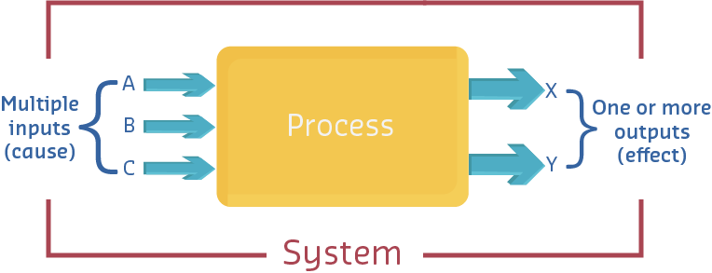
Systems, inputs, and outputs
A system may be defined as a set of things working together as parts of a mechanism or an interconnecting network; a complex whole.
In IoT, we run a program on our micro, which controls/reads a variety of actuators or sensors to perform a specific function - our system.

Slide 4
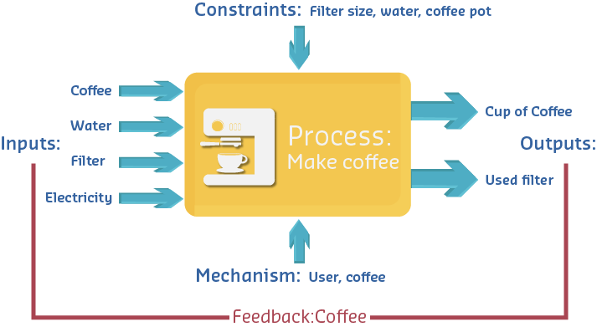
System examples: Coffee Pot
Notes:
Our inputs are: coffee, water, a filter, electricity
The output is coffee.
Note, however, that there are other inputs to our simple coffee pot system. The constraints can be the size of the coffee maker and the quantity of coffee and water available; the mechanism may be the need for someone to fill the filter with ground coffee and it insert into the coffee maker, pour water into the coffee maker, and so on.

Slide 5
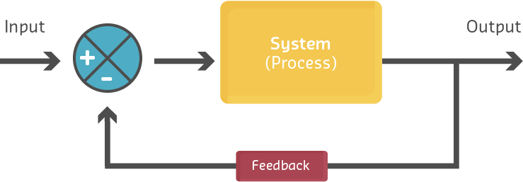
Closed-loop feedback system
The most common configuration is the closed-loop system. In this configuration, a proportion of the output of the system is fed back to the input and either added to (positive feedback) or subtracted from (negative feedback) the input. This results in the output of the system continually altering or updating the input with the current output conditions.

Slide 6
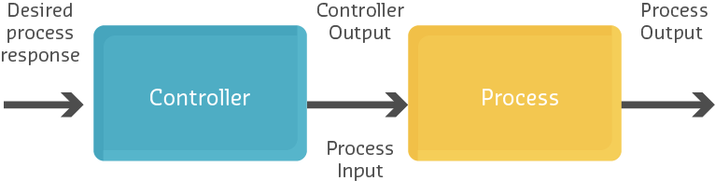
Open-loop control system
Another less common configuration is that of the open-loop system. In these cases, the system does not monitor or measure the condition of its output signal. For that reason, it is also called a non-feedback system.
Notes:
Video: Demo - Open and closed loop motor control
https://youtu.be/YRR_b-vEV8I
Video: Robotic car, closed loop control example
https://youtu.be/LfydfvHyikM

Slide 7
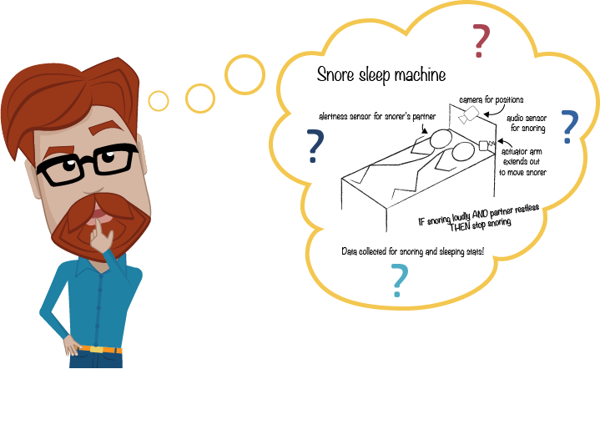
Design thinking

Slide 8
Activity
Discuss a problem that you have had recently (but nothing too personal!), or perhaps one experienced by someone you know. For example, our Everyman character has posted that his partner complains that he snores, which prevents them from falling asleep.
After discussing, take some time to firstly define the problem, and then do some research around possible solutions (whether IoT-related or not).

Slide 9
Defining the problem
Ask yourself:
What is the problem?
Who has this problem, and what do we know about them?
What are their concerns and needs?
How do they interact with their environment?
What causes the problem?
When does this problem occur?
Can you turn this problem into a question?

Slide 10
Questions for Defining a Problem
What is the Problem? | Snoring keeps partner awake and causes arguments between the couple.
Who has this problem, and what do we know about them? | A 40 year old woman (non-snorer)
What are their concerns and needs? | She is busy working mother who would like to get a good night’s sleep, while still being able to share a bed with her partner.
How do they interact with their environment? | She and her partner often have an alcoholic drink with their dinner. She also has back problems that sometimes wake her in the night.
What causes the problem? | Snorer partner having an open mouth or blocked nose which causes mouth breathing while asleep. Other partner not getting to sleep quickly, or sleeping lightly and getting disturbed.
When does this problem occur? | At night time, when the snorer goes to sleep and ends up on his back. If this happens before the other person is asleep, they are kept awake by the snoring.
Can you turn this problem into a question? | How can the snoring be stopped when it is a problem? (i.e. to allow the partner to get to sleep, or

Slide 11
Researching solutions
After defining the problem, begin to think outside the box. Try to explore other sectors to find examples of different angles from which to approach the problem.
Collect all your information together. Use the list below to interrogate your sources
Available solutions to this problem or similar, including those discovered through research
Pros and Cons of this solution? Cost and practicality?
How is it relevant, innovative and/or disruptive?
What are the limits of this solution?
What are the limits of this solution?

Slide 12
Example of Everyman’s Snore Stop solution.
What is the Problem?
A snorer keeps their partner awake
Available solutions to this problem or similar, including those discovered through research | Pros and Cons of this solution? Cost and practicality? | How is it relevant, innovative and/or disruptive? | What are the limits of this solution?
1. Seatec Chin Strap | $24 – affordable Physical device but may be uncomfortable to wear, cause chaffing? | Also a snoring stopping solution which will allow partner to get to sleep / sleep better. Deals with issues of devices staying on while sleeping. | Requires the snorer to wear something that might interrupt their sleep or cause skin irritation.
What can you identify as the key factors of success?
A. Simple, affordable, does not require partner to do anything

Slide 13
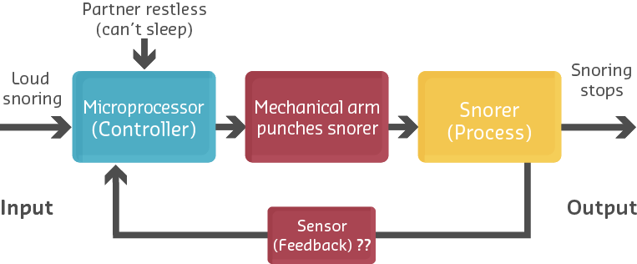
Process Diagrams
If you have an idea you can work with from the previous pages, or another solution you identified in your research, try to draw a process diagram like one you have seen in this module for open or closed loop control systems.

Slide 14
Design a system: Choosing sensors
Sensors play a significant role in any IoT system, and there are number of parameters to consider when selecting sensors for an IoT system.
Durability and stability
Power consumption
Connection range
Cost

Slide 15
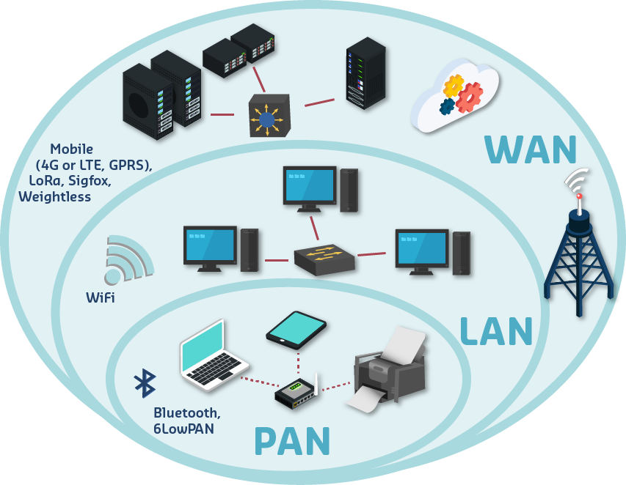
Design a system: Connecting devices
There are number of protocols and technologies to establish connection in different levels of an IoT system.
The three major, determinative parameters in selecting network technologies within IoT are:
coverage;
bandwidth; and
power consumption.

Slide 16
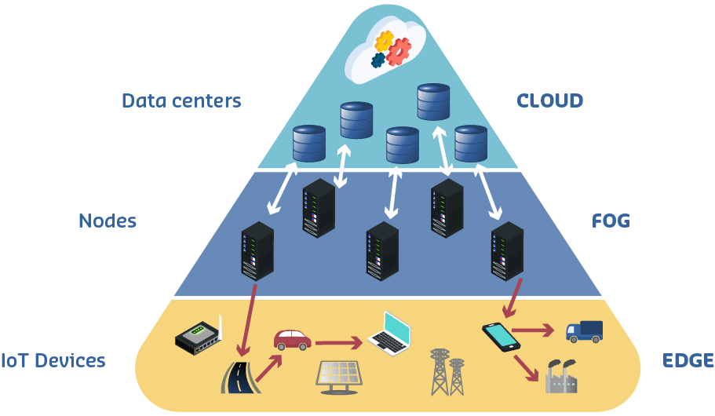
Design a system: Local storage and processing
The raw data collected from sensors needs to be stored and processed so it can be converted to useful information that can be utilised to make intelligent decision. The storage and processing of data are done in both Fog/Edge and Cloud level

Slide 17
Design a system - Which micro?
To help in the micro decision-making process, let’s look at how to determine the key requirements of your application:
1: Peripheral sensors and output components
2: Data communication protocols
3: Networking hardware and protocols
4: Processing
5: Data storage and transmission
6: Support

Slide 18
Design a system - Which micro?
1: Peripheral sensors and output components Determine the type and number of peripheral sensors and output components that you need. This will determine the GPIO requirements. Do not forget to include the required resolution (eg. 8 bit or16 bit DAC).
2: Data communication protocols Decide on the data communication protocols that you need to use for intra-device communication (e.g. serial to sensors, I²C to slave subsystems).
3: Networking hardware and protocols Select the networking hardware and protocols that you need to use to communicate with Cloud services.

Slide 19
Design a system - Which micro?
4: Processing: How much processing is required on the IoT device? Is it time critical? What sampling rates will you be using on your sensors?
5: Data storage and transmissionIs local data storage required? Does the device collect data and only transmit it occasionally, as would be the case with most wireless systems, to save power? If so, a micro with an operating system will reduce development time.
6: Support What support is available? Consider the level (and cost) of vendor support, availability of documentation, and even the number/activity of community forums. Is help going to be available when you need it most?

Slide 20
Design a system - Security requirements:
we are placing billions of additional devices onto the Internet, and each one is a place for hackers to attack. We must design with security in mind.
Steps may include:
Allow sufficient processing power for encryption/decryption of data and communications;
Include authentication methodologies for upstream communications and management;
Choose devices that are well supported by vendors, and include abilities to remotely update drivers and firmware;
Implement secure, hardened network technologies;
Physical security/rugged design. Often neglected is the issue of tampering, damage or theft of devices. This may include robust designs for use in hostile environments.

Slide 21
Physical design
The physical design is not just what your IoT device will look like, but an integral part of the commercialisation process. A good first step is to decide where the IoT device will placed.
If indoors:
It may be connected to a wired network in a reasonably clean, secure environment. In this case we may be able to make use of power over ethernet (PoE), thus saving the cost of battery replacement or mains power supplies. The housing need not be waterproof or sealed.
If installed outdoors:
We need to consider weatherproofing and how we will power the device. Weatherproofing may not be sufficient if, for example, the device is connected to a conveyor belt where dust and vibration may cause the device to fail.

Slide 22
Design a system - Powering your device
An important design implication is figuring out the best method to power your devices, whether that is the sensor, or micro, or actuator, or all together.
Power is often supplied by battery, but how do we recharge this? What size battery do we choose?
There are many ways of recharging, including solar panels or micro wind generators, to energy harvesting from vibration or motion.
Notes:
Schweber, Bill. 2016. “Options for Powering your Wireless IoT Device” Digi-Key Electronics; https://www.digikey.com/en/articles/techzone/2016/apr/options-for-powering-your-wireless-iot-device

Slide 23
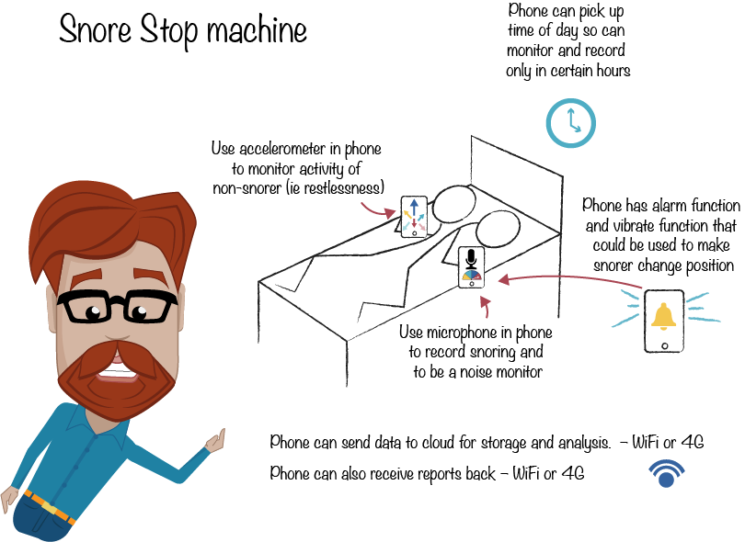
Putting all together
Have you an IoT system of your own in mind
Have you already:
Mapped out the process?
Identified what control systems are required?
Now, are you able to:
Choose the relevant sensors and/or actuators for your IoT design?
Understand how the devices will communicate?

Slide 24
References
ThinkGeek. 2012. Useless Box Kit from ThinkGeek. YouTube video 0:34, https://www.youtube.com/watch?v=aqAUmgE3WyM
Heflin, Michael. 2016. “The Nervous System of the IoT. MachineDesign online article; http://www.machinedesign.com/iot/nervous-system-iot

